Slide 1
EE6641 welcoming messages
Analysis and Synthesis of (Digital) Audio Signals, a.k.a. ASAS
Prof. Yi-Wen Liu
Sep. 15, 2015

Slide 2
Course pre-requisite
Digital Signal Processing, introduction level
Linear Algebra * * * *
Complex variables * * * *
Probability * *
Basic calculus * * *
Interests in audio, speech, and signal processing * *
Programming * * *
Prior experience with MATLAB *

Slide 3
Topics
Basic time-frequency analysis (6 weeks)
Warm-up weekly exercises
HW1: Testing your uncertainty limit
Music and speech－Analysis and Synthesis (6 weeks)
HW2: Time-warping and frequency shifting based on sinusoidal modeling
HW3: Mapping your vowels onto the F1-F2 space
Physiology and psychology of hearing (3 weeks)

Slide 4
Course format: 2 hrs lecture + 1 hr activity

Slide 5
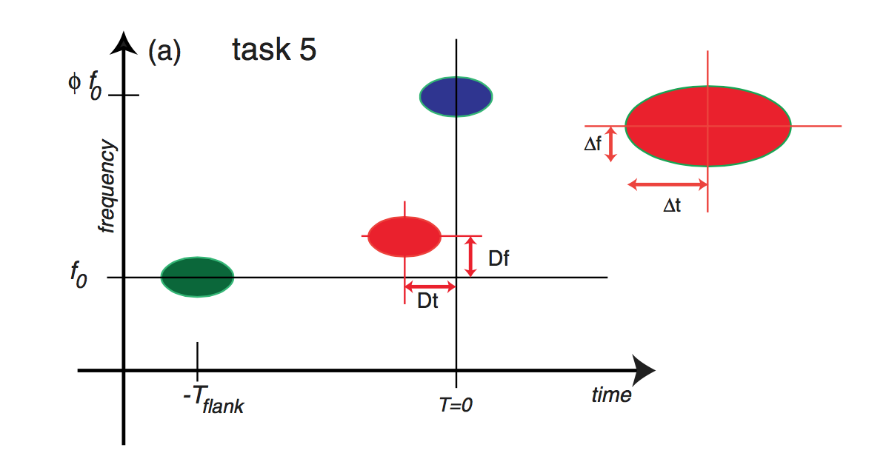
HW1: Testing your uncertainty limit
Oppenheim and Monasco, “Human Time-Frequency Acuity Beats the Fourier Uncertainty Principle,” Phys. Rev. Lett. 110, 044301 (2013)

Slide 6
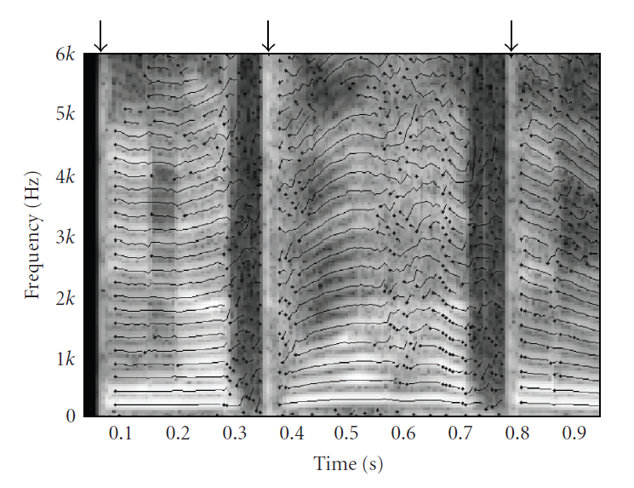
HW2: Sinusoidal Modeling and Synthesis

Slide 7
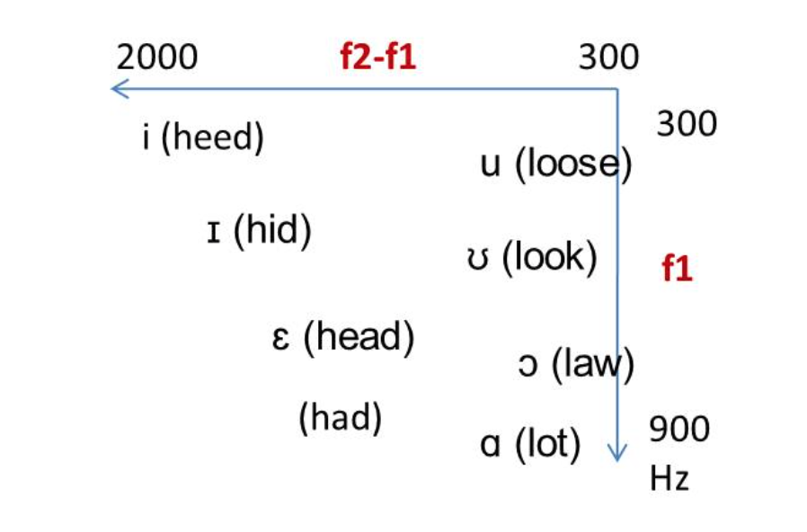
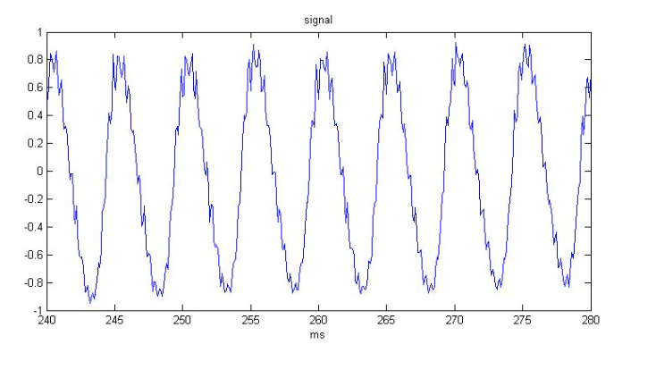
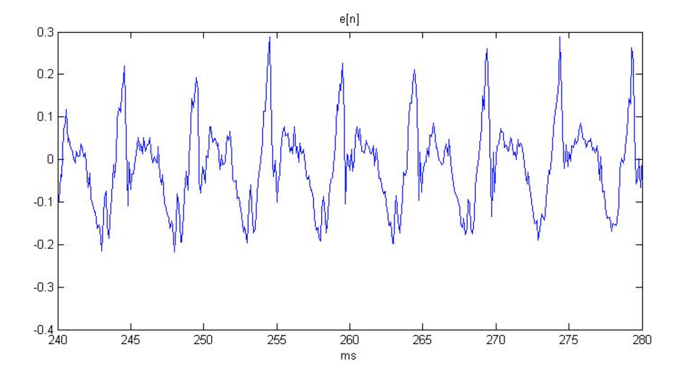
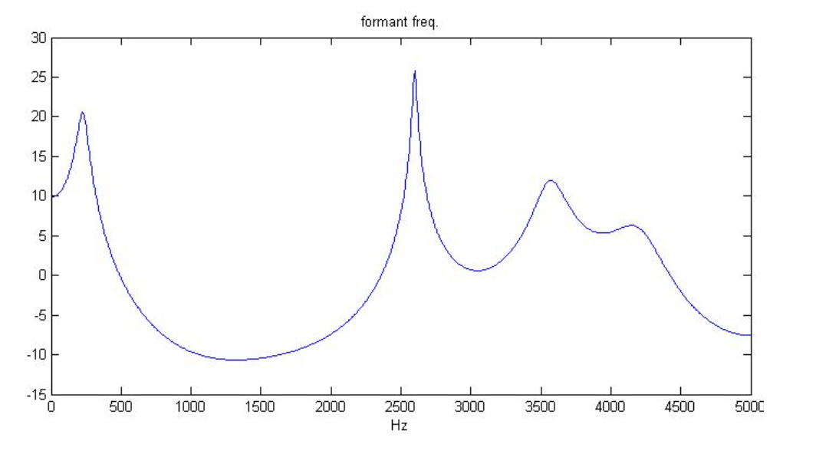
HW3: Mapping your vowels to F1-F2 space
Speech signal
=
X
Source
Filter

Slide 8

Final Project (20%): Voice transformer
Goal: Transforming a male voice to a female voice, or vice versa.
The HWs should give you sufficient know-how to begin.
Dec. 5: we will give a tutorial to discuss possible methods.
Dec. 29: I will talk about scientific writing.
Jan 5: Final presentation

Slide 9

We should attempt to beat this demo

Slide 10
All homework (45%) + the final project (20%) are team-based
Other items:
10 labs or reading reports (15%) -- individual
Final Exam (15%) – individual
Class participation (3%)

Slide 11
Weekly activity hour
Activities include
Lab1: Tone synthesis
Lab2: FFT and very simple spectral analysis
Lab3: Spectrogram
Lab4: Voice removal by band-reject filtering
Lab5: FFT-based filtering and overlap-add
Lab6: Find your pitch
Lab7: Spectral envelope calculation
+
Special topics and tutorials

Slide 12
Percentile-to-letter-grade conversion
The raw grades of the entire class will be ranked.
Your final grade will be determined according to your rank, instead of direct numeric-to-letter conversion.
A student with a higher rank will receive a grade no worse than that received by a student with a lower rank.
The grade boundaries will be solely determined by the teaching team after the ranking is calculated.
A+ assigned to no more than top 10% of the class.

Slide 13
Meet your TAs
黃彥學
李豪韋

